Slide 1

British Airways
Airline Review Analysis Insights
Summary of Key Findings from Skytrax Reviews
Name: Simran Kaur
Date: 1st February 2025

Slide 2
Introduction
This presentation summarizes key findings from an analysis of Skytrax airline reviews providing insights into customer sentiments, key drivers of satisfaction and areas for improvements.
Data was scraped from Skytrax focusing on reviews specifically about the airline itself.
Analysis include sentiment analysis, topic modelling and statistical analysis of various aspects of the reviews.
The findings will inform strategies to improve customer satisfaction and address areas of concern .

Slide 3
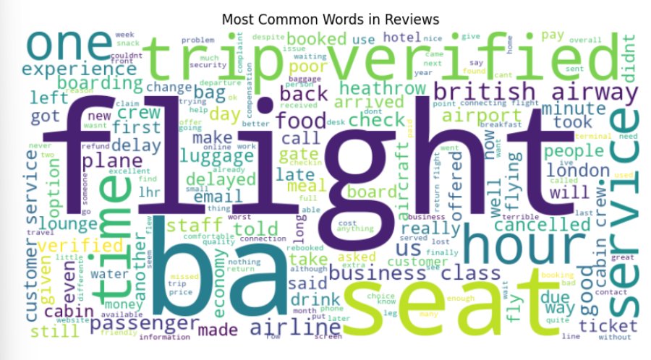
Word Cloud
Frequent Words – Flight, seat , staff service, time food , baggage class customer.
Positive aspects – Good great excellent comfortable friendly.
Negative Aspect – Delayed, cancelled lost issue, problem bad.
Neutral aspects – check, gate, time, boarding, airport plane.

Slide 4
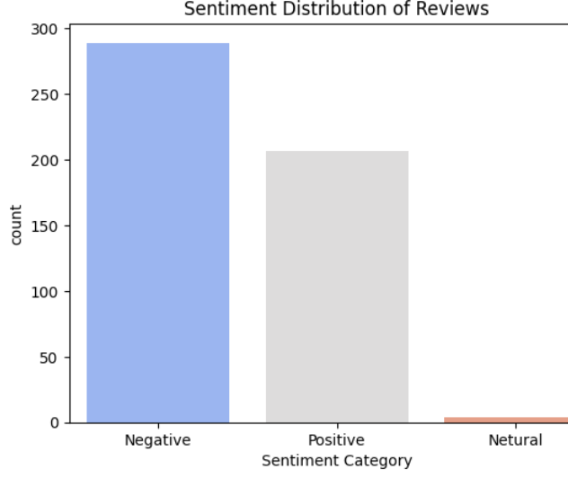
Sentiment Distribution of reviews
Negative sentiment – area of improvement. Negative reviews highlight specific areas for improvement
Positive sentiment - passengers appreciate these aspects. Positive reviews dominate, indicates overall satisfaction
Neutral sentiment – descriptive feedback on travel experience. Neutral reviews provide additional insights for enhancement.
Neutral

Slide 5
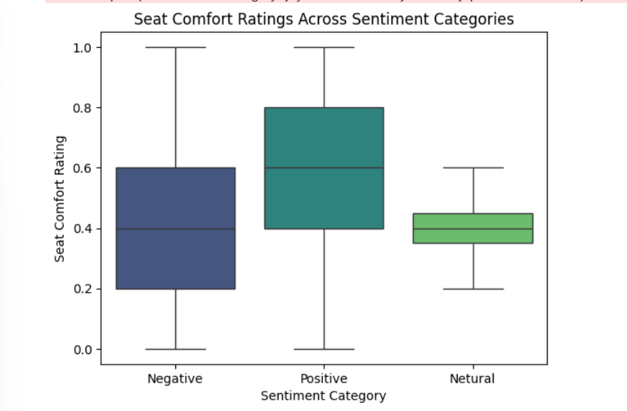
Seat Comfort Ratings
Positive sentiment - Higher seat comfort ratings (Evenly spread distribution).
Negative sentiment - Lower seat comfort ratings (Skewed left distribution).
Neutral sentiment - Moderate seat comfort ratings (Slightly skewed left distribution).

Slide 6
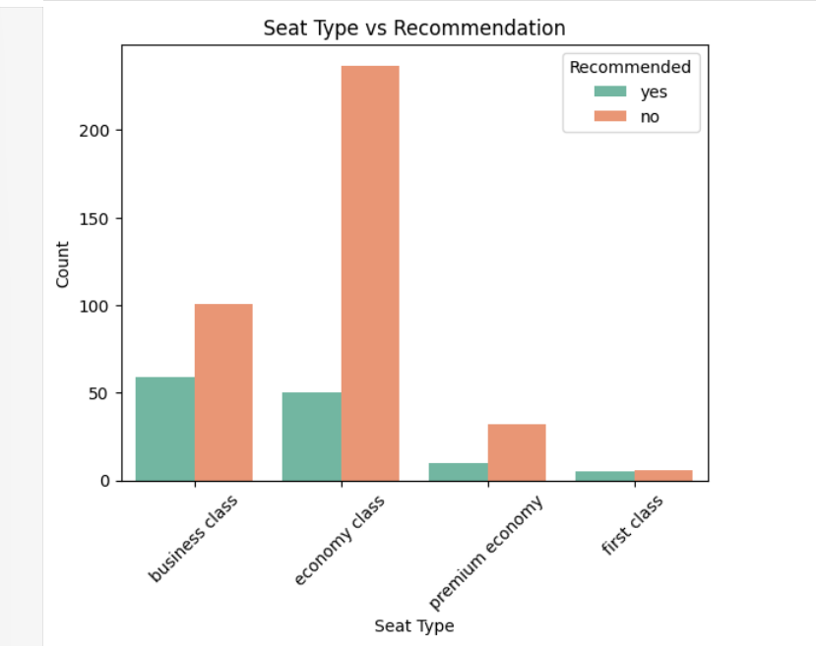
Recommendations from different classes
Business class highest number of “Yes” recommendations indicating high passenger satisfaction
Economy class Highest number of “NO” recommendations indicating areas for improvements

Slide 7
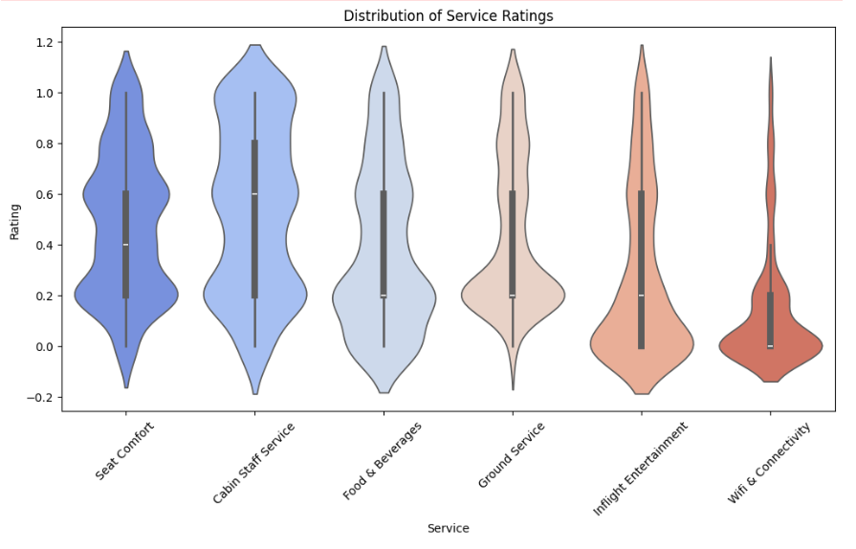
Distribution of Service Ratings
Cabin staff and food/Beverages
Highest Median ratings – overall satisfaction
Seat comfort and ground service
Wider distribution – mixed feedback
Inflight entertainment
Skewed distribution – common dissatisfaction
Wi-fi connectivity lowest rating – weakest service area
Central concentration – many customers still experience issues

Slide 8
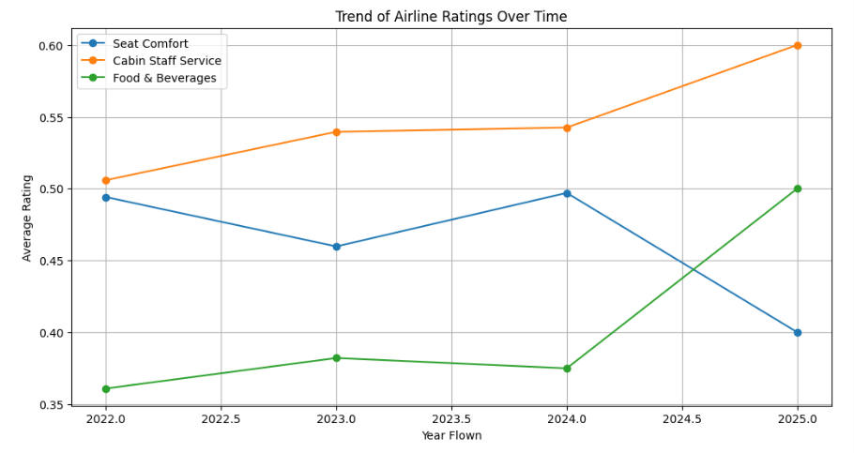
Trend of Airline Ratings over time
Seat comfort
Decreased from 0.50 (2022) to 0.40 (2025)- decline in satisfaction
Crew and Customer Service
Increased from 0.50 (2022) to 0.60 (2025) – improved satisfaction
Food and beverages
Increased significantly after 2023, reaching 0.50 (2025) – positive reception of improvement
We must focus on improving seat comfort while maintaining gains in crew service and food quality.

Slide 9
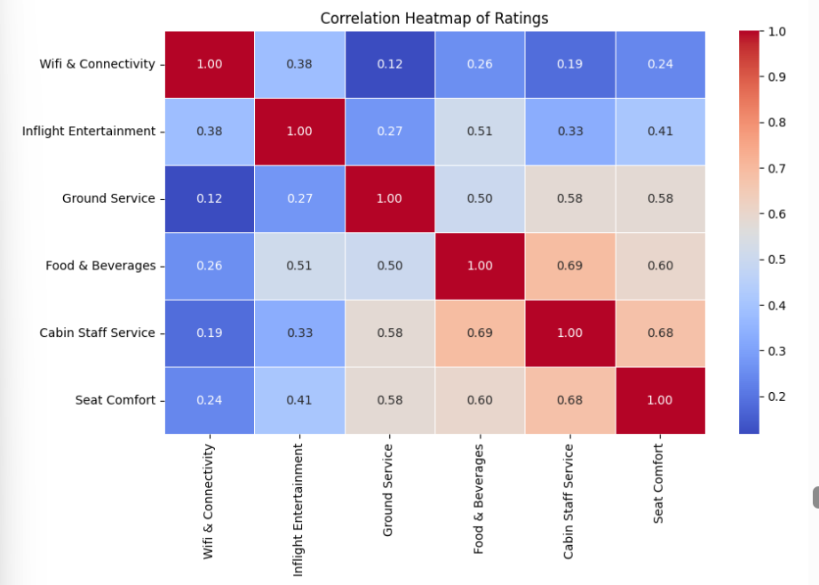
Correlation Heatmap of ratings
Strong positive correlation
Cabin staff service seat comfort(0.68)
Cabin staff food and beverages (0.69)
Moderate positive correlation
Seat comfort ground service (0.58)
Food and beverages inflight entertainment (0.51)
Weakest correlation
Wi-fi and ground service (0.12)
Wi-fi and cabin staff service (0.19).
Key takeaways –
focus on cabin staff service and ground service.
Wi-fi improvements are less impactful on overall satisfaction.

Slide 10
Summary of key findings
Sentiment Distribution – Positive sentiment dominates but negative and neutral reviews highlight area for improvement.
Seat comfort – declined over time.
Crew and customer service – improved over time.
Food and beverages – improved over time.
Inflight entertainment – skewed toward lower ratings, indicating common dissatisfaction.
Wi-fi and connectivity – lowest rating highlighting it as the weakest service area.

Slide 11
Recommendations For improving passenger satisfaction
Must focus on enhancing seat comfort, especially in Economy class to address declining ratings and negative feedback
Invest in better wi-fi services , as it is the weakest area with the lowest ratings
Continue efforts to improve food and beverages, as passengers have responded positively to recent changes
Improve ground services to positively impact seat comfort ratings and overall passenger experience
Enhance amenities and comfort in economy class to increase recommendation rate and satisfaction.

